Slide 1
High-Tech Etiquette: how polite are you?
Basic 12 Unit 10B

Slide 2
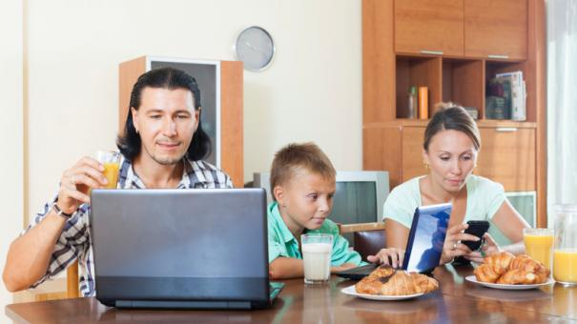
Does this look familiar?

Slide 3
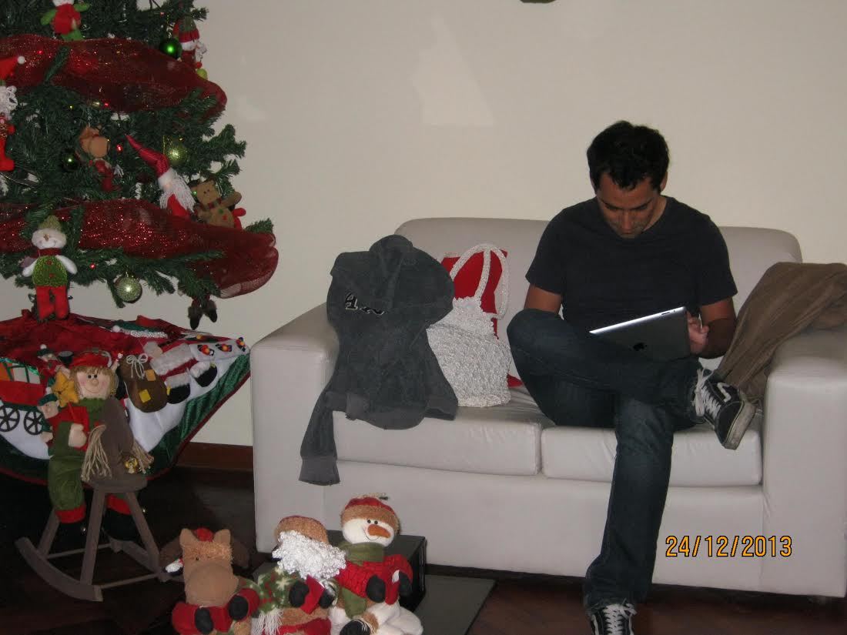
Does this look familiar?

Slide 4
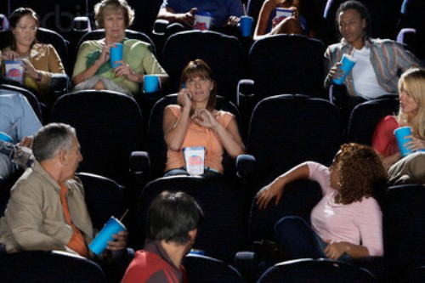
Has this happened to you?

Slide 5
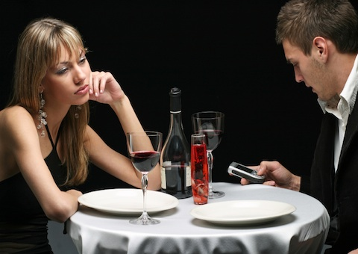
What´s happening here?

Slide 6
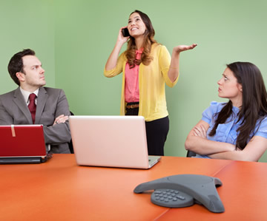
What´s happening here?

